Slide 1
Tutorial 6
Android App Development using Android Studio
CS551 Advanced Software Engineering

Slide 2
Topics
Android device features.
Media and Camera
Location services.
Running the application on the device.

Slide 3
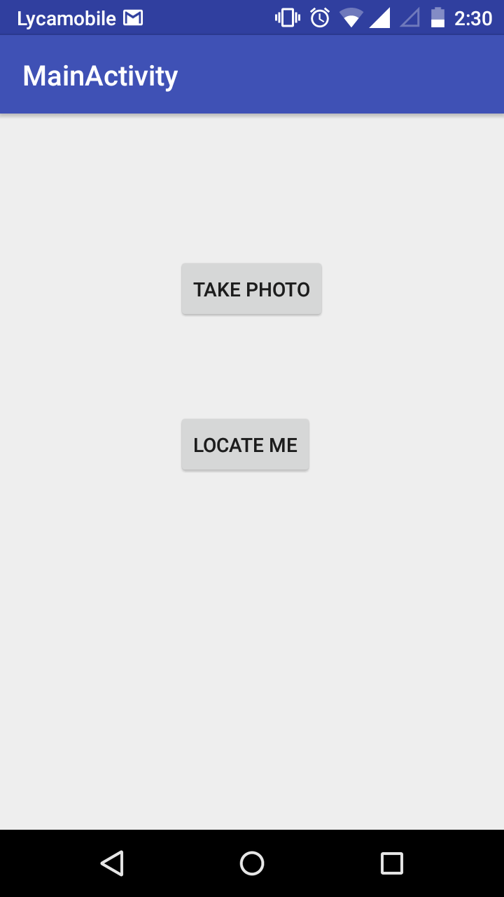
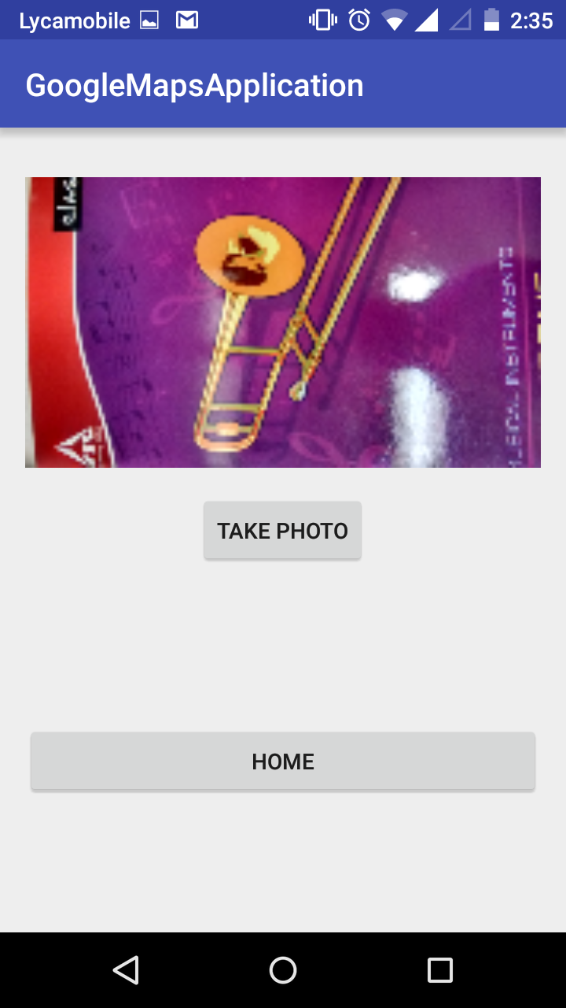
Outcome

Slide 4
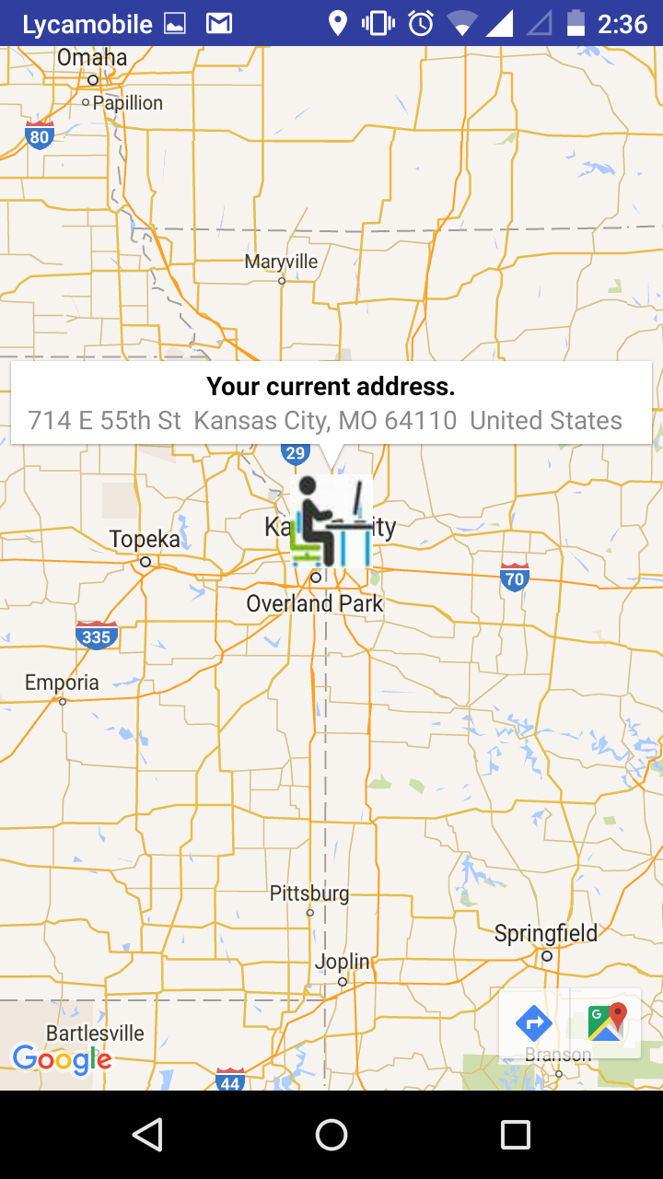
Outcome

Slide 5
Android Media and Camera
Several features present in Android that are accessible to the code.
Developers can add Audio, Video and image capabilities to their app using in built libraries in Android.
Eg: Camera Library
Camera can be accessed through
android.hardware.camera2
Camera Intent
http://developer.android.com/guide/topics/media/camera.html

Slide 6
Android Location and Maps
Applications can access the location of the user to improve functionality.
android.location package contains the classes and methods for accessing location.
LocationManager is the central component of location framework.
LocationProvider is used to query for the user’s last known location.
http://developer.android.com/guide/topics/location/index.html

Slide 7
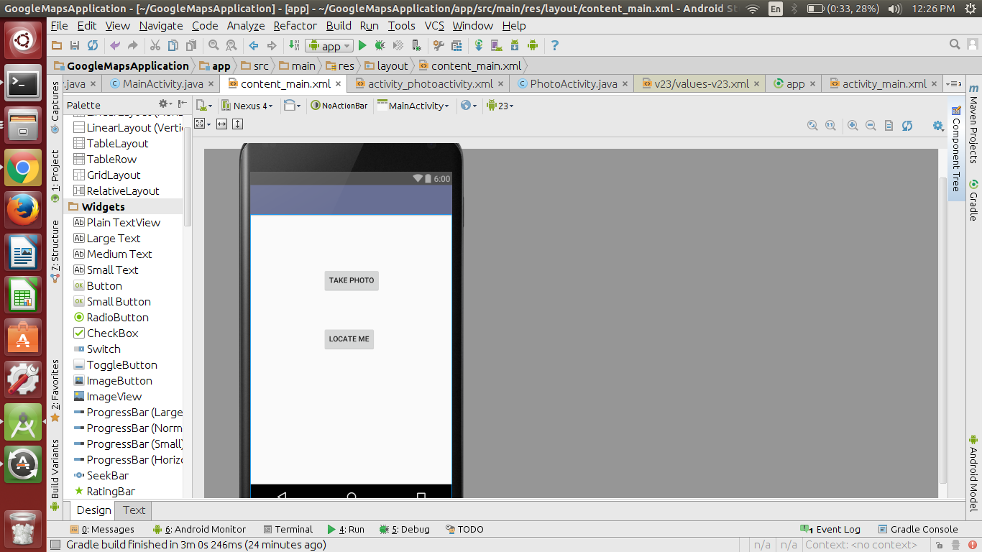
Tutorial application activity_main.xml screen

Slide 8
MainActivity.java code
@Override
protected void onCreate(Bundle savedInstanceState) {
super.onCreate(savedInstanceState);
setContentView(R.layout.activity_main);
Toolbar toolbar = (Toolbar) findViewById(R.id.toolbar);
setSupportActionBar(toolbar);
getActionBar().setTitle("Home page");
button_map = (Button) findViewById(R.id.main_btn_maps);
button_photo = (Button) findViewById(R.id.main_btn_photo);
}
public void onClickOfMapButton(View v) {
//This code redirects the from main page to the maps page.
Intent redirect = new Intent(MainActivity.this, MapsActivity.class);
startActivity(redirect);
}
public void onClickOfPhotoButton(View v) {
//This code redirects to the photo activity.
Intent redirect = new Intent(MainActivity.this, PhotoActivity.class);
startActivity(redirect);
}
Redirection to the selected button
activity.

Slide 9
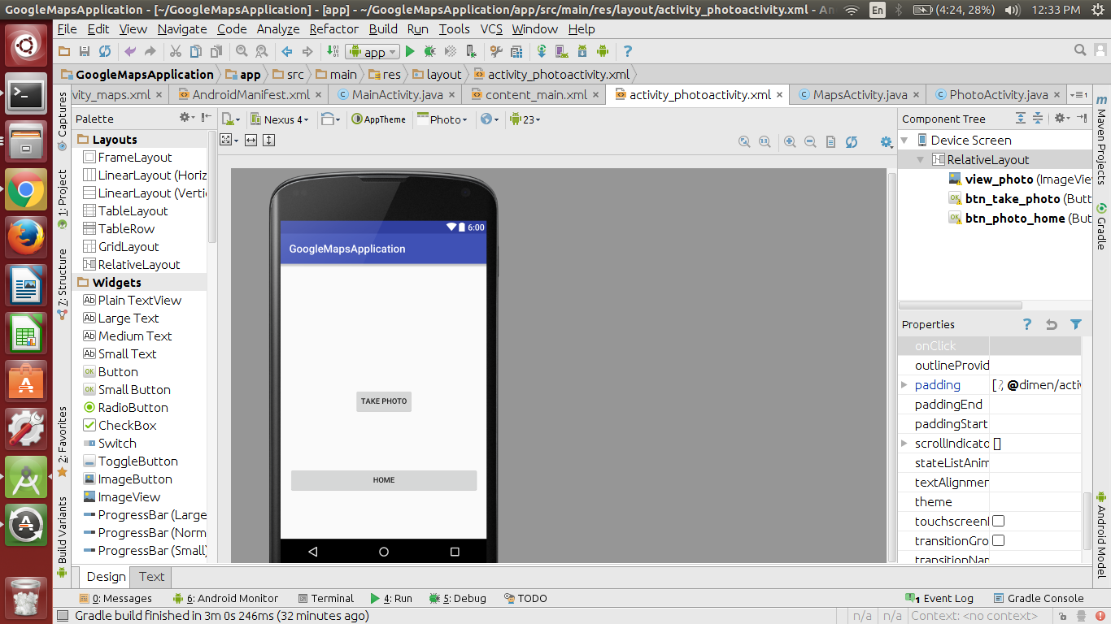
Tutorial application activity_photoactivity.xml screen

Slide 10
PhotoActivity.java code
Button capture = (Button) findViewById(R.id.btn_take_photo);
//Button click eventlistener. Initializes the camera.
capture.setOnClickListener(new View.OnClickListener() {
public void onClick(View v) {
Intent cameraIntent = new Intent(MediaStore.ACTION_IMAGE_CAPTURE);
startActivityForResult(cameraIntent, TAKE_PHOTO_CODE);
}
});
@Override
protected void onActivityResult(int requestCode, int resultCode, Intent data) {
super.onActivityResult(requestCode, resultCode, data);
if (requestCode == TAKE_PHOTO_CODE && resultCode == RESULT_OK) {
Bitmap photo = (Bitmap) data.getExtras().get("data");
userImage.setImageBitmap(photo);
Log.d("CameraDemo", "Pic saved");
Accessing the device camera and starting it.
If successful in capturing the image it redirects to OnActivityResult.
Inside OnActivityResult we set the imageView with the image captured.

Slide 11
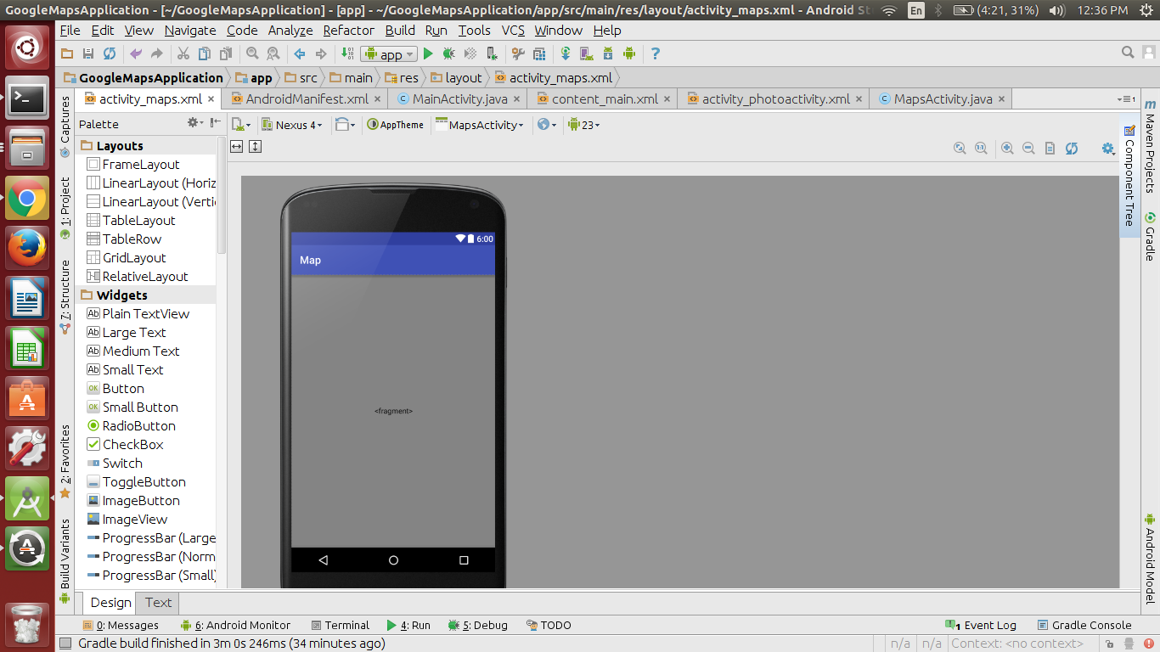
Tutorial application activity_maps.xml screen

Slide 12
MapsActivity.java code
if (ActivityCompat.checkSelfPermission(this, Manifest.permission.ACCESS_FINE_LOCATION)
!= PackageManager.PERMISSION_GRANTED && ActivityCompat
.checkSelfPermission(this, Manifest.permission.ACCESS_COARSE_LOCATION)
!= PackageManager.PERMISSION_GRANTED) {
//show message or ask permissions from the user.
return;
}
//Getting the current location of the user.
userCurrentLocation.requestLocationUpdates(LocationManager.GPS_PROVIDER, 0, 0, userCurrentLocationListener);
latitute = userCurrentLocation .getLastKnownLocation(LocationManager.GPS_PROVIDER).getLatitude();
longitude = userCurrentLocation.getLastKnownLocation(LocationManager.GPS_PROVIDER)
.getLongitude();
userCurrentLocationCorodinates = new LatLng(latitute,longitude);
Cheking if the app has permissions to
access the user location. If not you can
ask permission or show a message.
Using the GPS service we are getting the last known coordinates of the user.
LocationListener is similar to event listener. In case the user location changes then we need
to get the location and show it using the location listener.

Slide 13
MapsActivity.java code
Getting the address of the user based on latitude and longitude.
try {
List<Address> addresses = geocoder.getFromLocation(latitude, longitude, 1);
Address address = addresses.get(0);
userAddress = new StringBuilder();
for (int i = 0; i < address.getMaxAddressLineIndex(); i++) {
userAddress.append(address.getAddressLine(i)).append("\t");
}
//Setting our image as the marker icon.
mMap.addMarker(new MarkerOptions().position(userCurrentLocationCorodinates)
.title("Your current address.").snippet(userAddress.toString())
.icon(BitmapDescriptorFactory.fromResource(R.drawable.marker_maps)));
//Setting the zoom level of the map.
mMap.moveCamera(CameraUpdateFactory.newLatLngZoom(userCurrentLocationCorodinates, 7));
The above code sets the text and icon of the image for the marker. The level of the zoom is controlledin the last line of code.

Slide 14
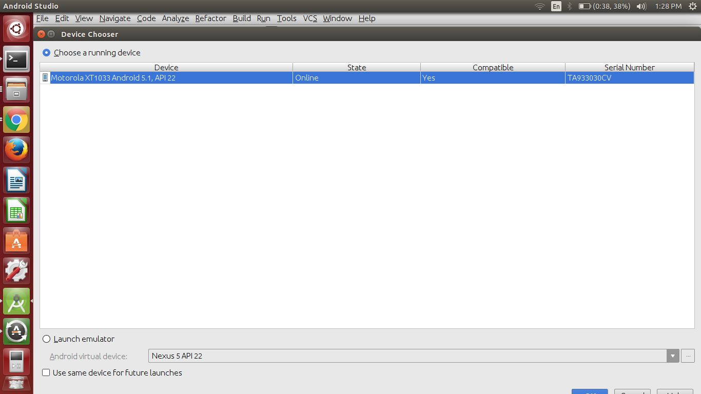
Running application on device
Enable USB Debugging on your device.
http://www.recovery-android.com/enable-usb-debugging-on-android.html
2. Connect your device through a USB cable.
3. Click Run button on Android studio.
4. Select your device from the list.
5. Click OK

Slide 15
Demonstration

Slide 16
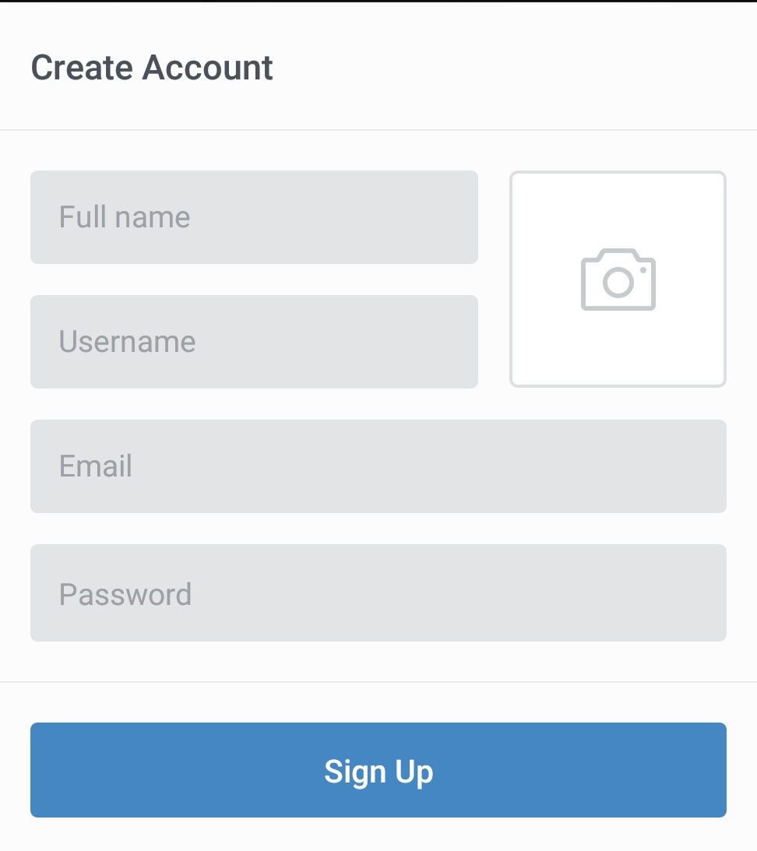
Task
Create a signup page with Basic details like First name, Last name, Image, Address etc.
Image should be populated by using Camera or Gallery.
Address should be populated using Location Manager.
After Signup, show an Activity named “Home” which has a Map with Custom Marker (Use the image from Signup form) at current location.
Hint for the gallery feature would be
Intent.ACTION_GET_CONTENT or
Intent.ACTION_PICK
This is a reference UI.
More inspiration can be found on http://pttrns.com/patterns?scid=9

